Slide 1






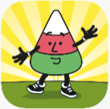




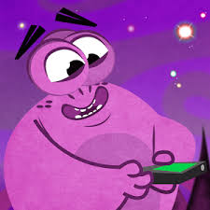



Apiau Cymraeg
Blynyddoedd 3-6 Years 3 - 6
(All available on Apple. On Android too unless marked )
 | Aur am Air Play games work your way around an island. Games reinforce letter sounds and word recognition. Interface like Minecraft.
 | Cyfres Cychwyn Eto Simple story books with sound to help pronunciation. 3 vocabulary games for each story.
 | Betsan a Roco yn y dref 1 A set of 8 digital books with sound, focussing on topics such as animals, travel, food and leisure.
 | Mistar Urdd Two stories: ‘Mr Urdd yn Mynd ar Daith, Brycheiniog a Maesyfed’ and ‘Mr Urdd yn Mwynhau’ with sound, English translations and sign language.
 | Guto Nyth Brân Help Guto win the race by completing spelling challenges of a variety of vocabulary on 3 different levels. (Years 3 – 4)
 | Hapus 1 & 2 Made by Athrawon Bro Powys to go with the key stage 2 vocabulary and language patterns for holiday news (1) and personal details (2)
 | Codi Hwyl Play vocabulary games on a pirate ship – matching pairs or steering the ship towards the correct picture.
 | Campau Cosmig / Campau Cosmig 2 6 planets each with a different challenge: spelling, word search, punctuation, correct yes/no, numeracy and vocabulary (1) and mutations (2)
 | Ap Iaith Move around the island playing games based on different language elements, such as tenses, idioms and vocabulary.
 | Anagramau Ail Iaith Re-arrange the letters to spell the name of the item shown in the picture. Timed challenges on 3 levels.
 | Brawddegau Ail Iaith Re-arrange the words to create the sentence. Includes questions, different tenses, opinions, and language patterns linked to school.
 | Sillafu Ail Iaith Type out the words correctly: create plurals, listen and type, translate and type, type the word in the picture.

